Slide 1

Meeting New Expectations:
Transparency, Compliance, and Governance
A Joint Presentation by IDC Government Insights and Microsoft
May 20, 2009

Slide 2
Agenda
Overview of 2009 Government Trends and Issues by IDC Government Insights
New Tools for a New Era
  Microsoft Single View Platform
  Microsoft Stimulus 360 Solution
Q & A

Slide 3
New Government Trends, Challenges, and Issues in 2009
Thom Rubel
Practice Director, Government Programs
IDC Government Insights

Slide 4
The 2009 Government Challenges
Financial Stability – governments’ new business role
Economic Recovery - The American Reinvestment & Recovery Act
New Expectations – transparency and accountability
Smart Execution – risks and results

Slide 5
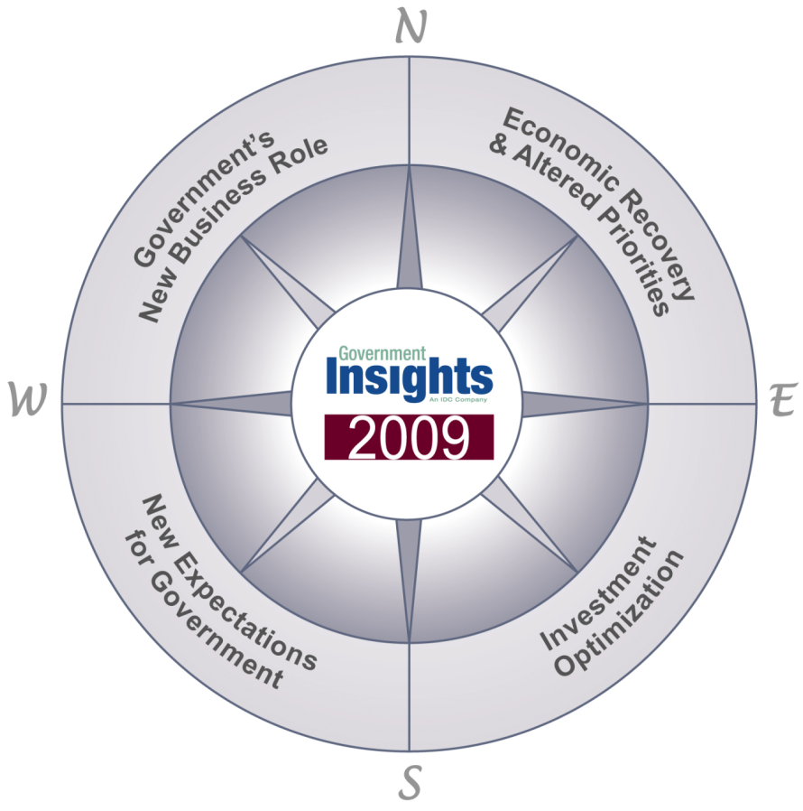
Mega Trends for Government 2009
Managing and overseeing institutions in which it has invested to stabilize the economy
Stimulating the economy through various programs and new executive priorities
Citizens looking for government leadership in rebuilding the economy, supporting their needs, and keeping them informed
Further reducing operational costs while improving IT capabilities and capacity

Slide 6
The President’s Strategy
Full & free exchange of ideas
  Protect the openness of the Internet
  Balance right to free speech with privacy and security
Transparent & connected democracy
  Use technology to open government to the citizen
  Use technology to reform government operation
Solve the nations most pressing problems
Health Care
Economy
Public Safety
Education
Energy
Deploy a modern communication infrastructure
  Next generation broadband
  Eliminate the digital divide
Improve U.S. competitiveness
  Invest in science research
  Prepare the children for 21st century
  Prepare adults for changing economy

Slide 7
The President’s Vision
“…..let us be the generation that reshapes our economy to compete in the digital age.”
Fundamental beliefs
  Technology and innovation create immense transformation power to improve the lives of Americans
  All Americans should have the chance to participate in government deliberations and decision-making
Transparency
Accountability
Participation
Trust

Slide 8

Trends and Issues
Economic Recovery & Altered Priorities
Massive worldwide government spending to provide economic security and spur economic growth
Social safety net issues come first
New public infrastructure investments
Immediacy to spur job creation

Slide 9

Trends and Issues
Governments’ New Business Role
Capital Assistance Program
  Investment in banks
Consumer & Business Lending Initiative
  Loan guarantees
Making Home Affordable Program
  At risk homeowners
Public Private Investment Program
  Troubled Asset Recovery Program (TARP)
Notes:
9

Slide 10
Trends and Issues
Governments’ New Business Role
Non-traditional roles for some governments as business partners in traditionally private sector institutions
Governments will stumble in their new temporary role of managing financial institutions and related "bail-out" programs, which require new skills, training, and technology
Notes:
10

Slide 11
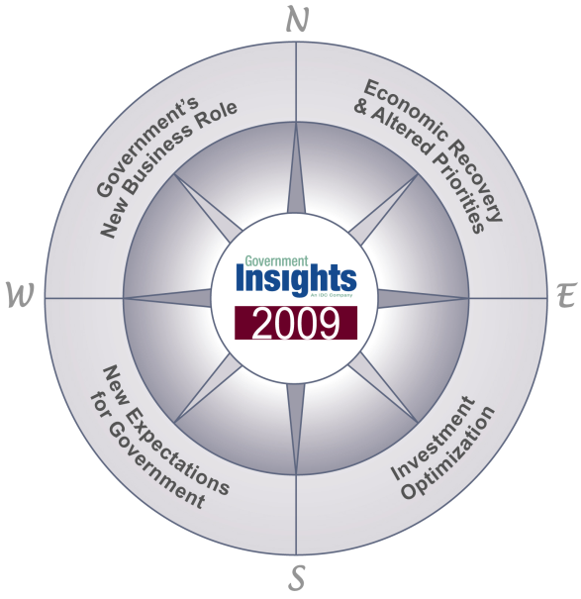
Trends and Issues
New Expectations for Government
Awareness – First significant election for tech-friendly policymakers
Expectations – Economy and elections have created a big shift in citizen expectations for government
Technology Shifts – Social networking, instant communication, transparency

Slide 12
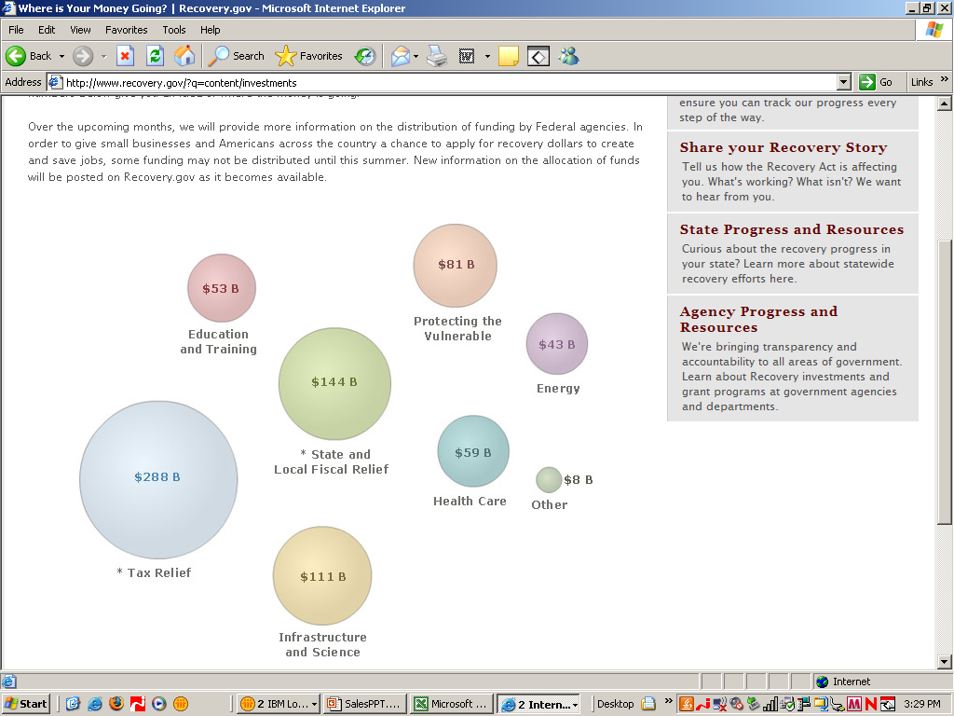
American Recovery and Reinvestment Act (ARRA) and the High Tech Industry
The $787 billion Act will stimulate $101 billion in technology spending
    $77.6 billion in Energy
    $21.1 billion in Healthcare
    $2.5 billion in Government
ARRA Intersection Opportunities
    Federal Health IT in Government
      Defense Health Facilities
      Indian Health IT & Facilities
      SSA Disability Health Record
      HHS Coordination of electronic health record strategy
    Education
      Statewide Data Systems
      Education Through Technology
    Energy
      Upgrade to Government Facilities & Fleet
      Smart Grid
    Infrastructure
      23% in Government
      77% in Private Sector

Slide 13
2009 ARRA Summary
American Recovery and Reinvestment Act of 2009 - $787 billion
  $302 billion in direct government spending
  $288 billion in tax relief provisions
  $197 billion in direct spending to individuals
Provides funding to agencies for new and existing programs
  Federal agencies define program requirements and guidelines
  Specific IT funding is often embedded in priority programs
  Over 61% is provided to states via federal grant programs
Utilize existing processes – just “faster”
  Federal Acquisition Regulations still apply
  Fixed Price Contracts are required
  Priority given to “shovel ready” initiatives
Oversight, Transparency and Accountability
  $316 million to specific federal oversight entities
  $2.85 billion to program management oversight, federal and/or state
  Newly created federal Recovery Accountability and Transparency Board
  Recovery.gov is established to monitor spending

Slide 14
Trends and Issues
Transparency
Citizens:
  How will government fix it?
  How did we get into this in the first place?
  How do we avoid it happening again?
Government:
  ARRA reporting requirements = results and accountability
  “Democratization of data”
Notes:
14

Slide 15
Stimulus Act – How the Money Flows
ARRA Spending
Borrow Auth
Loan Guar
Specific IT funding is often embedded in priority programs
Over 61% is provided to states via federal grant programs
Loan
$$ in Millions
Pgm Fund
Direct
Grant
$0
$50,000
$100,000
$150,000
$200,000
Spending Category

Slide 16
U.S. Stimulus Act – Reporting is Critical and Expansive
Oversight, Transparency and Accountability
  Over $3.166 billion specifically for management and oversight activities
  Recovery.gov is established to monitor spending
  Newly created Recovery Accountability and Transparency Board
ARRA Oversight Money
Agency Level Oversight (IG Offices)
GAO
$2.85 billion
Recovery Act Transparency Board
Program Level Oversight

Slide 17
The Risks to Economic Recovery
Government moves slowly….when quick action is needed
Reporting
  Went from extreme of too little to too much
  Both frequency and complexity of reporting requirements will divert attention from achieving results
Increased potential for fraud
Increased cyber security attacks
Requirement for security and privacy is in conflict with position of openness and usage of social media

Slide 18
Smart Execution
Government agencies on the spot to report results
Limited funding for program administration/reporting
Existing infrastructure and systems will have to deliver
Enterprise information is critical to success
Government needs strategic/innovative solutions to key reporting issues

Slide 19
Microsoft® Single View Platform (SVP) for Financial Revitalization –
Achieving transparency, governance, and compliance through unfettered access to detailed information
Ken Knueven
Microsoft Federal Programs Manager
Gina Marie Hatheway
Microsoft Government Programs Manager

Slide 20

Financial Revitalization
New Administration Priorities Affect:
  State and Local -- Banks, Mortgage Brokers; Bankruptcy Courts
  Fannie Mae and Freddie Mac – Government managed - they will do much of the heavy lifting.
Key Federal Agencies Involved
  Department of the Treasury
    Office of Financial Stability (OFS)
    Office of Thrift Supervision (OTS)
    Comptroller of the Currency (OCC)
  Federal Reserve
  Federal Deposit Insurance Corporation (FDIC)
  Housing and Urban Development (HUD)
  SEC; SSA; PBGC; Commerce
  and others TBD:
Key Commercial Entities Involved
  Almost all Major Banks & Financial Institutions
  Chrysler, General Motors
  Mortgage lenders
  Borrowers
  TBD ..?
The Administration’s new Financial Stability Plan expands on several initiatives developed under the old EESA and TARP programs:
Financial Stability Trust
  A Comprehensive Stress Test for Major Banks
  Increased Balance Sheet Transparency and Disclosure
  Capital Assistance Program
Public-Private Investment Fund ($500 Billion - $1Trillion)
Consumer and Business Lending Initiative (Up to $1 trillion)
Transparency and Accountability Agenda – Including Dividend Limitation
Affordable Housing Support and Foreclosure Prevention Plan
A Small Business and Community Lending Initiative
Notes:
This will have implications down through State and Local (Banks, Mortgage Brokers; Bankruptcy Courts) as well as with Fannie and Freddie (a large portion here) – which are under conservatorship of the Federal Housing Finance Agency -- they will do much of the heavy lifting.
The administration set aside $75 billion for this program, which enlists borrowers, lenders and the servicers who collect the monthly mortgage payments. It is made up of $50 billion from the $700 billion financial bailout fund approved last year, and up to $25 billion from housing finance firms Fannie and Freddie. It also draws on up to $200 billion authorized by last year's housing bill.
Treasury Secretary Tim Geithner presented the Obama Administration's plans for disbursement of the remaining $350 billion in Troubled Assets Relief Program (TARP) funds authorized by Congress earlier this year. In addition to announcing the creation and modification of programs within TARP, President Obama's economic team laid out its comprehensive blueprint for addressing the housing and credit crises. The Treasury's announcement is part of a coordinated effort by the Administration to jumpstart the nation's economy.
The Administration's proposal expands on several initiatives developed under former Treasury Secretary Paulson, providing additional tools with which the federal government can respond to disruptions in the housing and financial markets. Since implementation of the Emergency Economic Stabilization Act (EESA) and TARP program began in October 2008, the program has come under intense congressional scrutiny on a range of issues, including executive compensation, lack of increased consumer access to credit, lack of transparency, and limited oversight of use of TARP dollars. In response, numerous legislative efforts have been introduced in an effort to place additional requirements on the Treasury with respect to use of TARP funds. The new package of TARP programs attempts to address these concerns and implement a more comprehensive approach to the markets in response to Congressional oversight.
Implementation of the Administration's new Financial Stability Plan is more far-reaching in its scope than prior efforts, and is based on extensive coordinated action by the Treasury, Federal Reserve, FDIC, Freddie Mac, Fannie Mae, Bankruptcy Courts; Lenders; State and Local Regulatory bodies, and other government entities. Full implementation of the plan will likely require additional congressional authorization, particularly with respect to additional spending authority that may be required. As with other new initiatives announced by the Obama Administration, a centralized website to promote transparency has been established (www.financialstability.gov) to provide updates to the public on the implementation of the program.
The announcement did not address the specific structures or details of the new recovery program, but did provide an outline of the principles and elements of the Financial Stability Plan. Given early market reaction and the need for swift action, we anticipate further announcements as the parameters are more fully developed.
The new program contains five central areas of focus:
Creation of a public/private partnership to purchase non-performing , illiquid legacy assets from financial institutions;
Creation of a forward-looking supervisory regime, including a financial "stress test" to assist institutions in managing their balance sheets and ensuring adequate capitalization;
Creation of a comprehensive housing program to forestall foreclosures and stabilize the residential mortgage market;
Expansion of the Term Asset-Backed Securities Lending Facility (TALF); and
Creation of a small business and community lending initiative.
Public-Private Investment Fund
The Treasury, in concert with the FDIC and Federal Reserve, plans to create a capital partnership to assist in disposition of illiquid assets on institutions' balance sheets. Though little specific information was provided, the Investment Fund will seek to leverage private capital with public funds on an initial scale of $500 billion, with the potential to expand to $1 trillion. Private sector equity contributions will be expected to make large-scale asset purchases, allowing private sector buyers to determine the price for current troubled and previously illiquid assets
Supervisory Enhancement and Stress Test
Working with federal banking regulatory agencies, the Treasury will also develop a forward-looking financial transparency framework to assess institutional balance sheet and capitalization pressures to stem additional negative impact of exposure to illiquid assets. A key component of the plan will be a comprehensive "stress test" that requires an assessment of whether major financial institutions have the capital necessary to continue lending and to absorb the potential losses that could result from market forces and continued economic recession. Institutions with assets in excess of $100 billion will be required to participate in the supervisory review and stress test process.
The Treasury will also establish a Financial Stability Trust from which institutions may draw funds to buffer themselves from addition downturns and ensure capital adequacy. Firms will receive a preferred security investment from the Treasury in convertible securities that they can convert into common equity if needed to maintain capital ratios to preserve lending in a worse-than-expected economic environment. This convertible preferred security will carry a dividend (as yet unspecified) and a conversion price set at a modest discount from the prevailing level of the institution's stock price as of Feb. 9, 2009. Banking institutions with consolidated assets below $100 billion will also be eligible to obtain capital from the Treasury after a supervisory review.
Housing Stability Program
In conjunction with the FDIC, the GSEs (Freddie and Fannie), and the Federal Reserve, the Treasury will develop a comprehensive program to stabilize the housing market. Sec. Geithner provided little detail on the plan, noting its full scope would be announced at a later date. However, the Treasury has committed $50 billion in TARP for expansion of the FDIC's current loan modification program. Additionally, the Treasury announced continuation of its efforts to use $600 billion for purchasing of GSE mortgage-backed securities and GSE debt. Finally, the Treasury will development and implement a program that will require Financial Stability Plan participants to participate in mandatory mortgage modification programs.
TALF Expansion
The Treasury and Federal Reserve will increase the size and scope of the current TALF program. The Treasury has previously committed $20 billion on TARP dollars to implementation of the program to restart commercial lending securitization backed by auto, student, credit card, and Small Business Administration loans. The Financial Stability Plan will create a "Super TALF" program with up to $100 billion in funds available which may be leveraged to $1 trillion. Eligible collateral will be expanded to include commercial mortgage-backed securities (CMBS). In addition, the Treasury will continue to consult with the Federal Reserve regarding possible further expansion of the TALF program to include other asset classes, such as non-Agency residential mortgage-backed securities (RMBS) and assets collateralized by corporate debt.
Small Business and Community Lending Initiative
The Treasury and Small Business Administration (SBA) will develop a program to assist small businesses' credit access. In addition to inclusion in the TALF program, the federal guarantee on SBA loans will be increased to 90 percent and the approval process will be streamlined to inject capital into small businesses.
In addition to announcement of these new programs, Sec. Geithner laid out a plan for increased oversight and transparency for recipients of assistance under the new Treasury program. Of note, these new standards will not be retroactive to firms that have already received TARP funds.
New requirements include:
Adherence to executive compensation standards released last week (http://treas.gov/press/releases/tg15.htm);
Requirements that recipients submit plans on how government funds will be used to spur additional lending;
Requirements that firms submit monthly reports on their lending broken out by category, showing how many new loans they provided to businesses and consumers and how many asset-backed and mortgage-backed securities they purchased, accompanied by a description of the lending environment in the communities and markets they serve. These reports will also include a comparison to their most rigorous estimate of what their lending would have been in the absence of government support; and
Limitations on dividends to firms receiving "exceptional assistance" to $0.01 per share quarterly; limitations on stock buybacks, and restrictions on cash acquisitions of healthy firms until government funds have been repaid.
Review everything at the Financial Reform Team Site -- http://sharepoint/sites/Federal%20Financial%20Revitalization/default.aspx

Slide 21
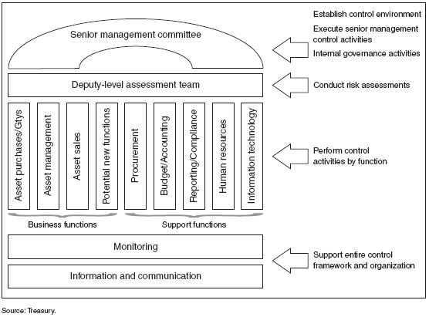
Office of Financial Stability
Required Framework for Internal Control
Recommendations
Establish common systems and tools. Establishing common systems and tools across the regulatory environment will help integrate agencies towards a more unified regulatory environment. Options include:
Create an automated workflow capability through COTS products (via a target architecture)
Create real time collaboration and data sharing capabilities
Develop integrated analytics
Develop standard reporting mechanisms and leverage automated work flow and collaboration capabilities
Create capability for ad hoc analytics and reporting by leveraging common data warehouse
Implement a Federated approach utilizing a common business model and shared information staging areas as an iterative approach to quickly move toward aggregated data
Notes:
Control environment—creating a culture of accountability by establishing a positive and supportive attitude toward improvement and the achievement of established program outcomes.
Risk assessment—performing comprehensive reviews and analyses of program operations to determine if risks exist and the nature and extent of risks have been identified.
Control activities—taking actions to address identified risk areas and help ensure that management’s decisions and plans are carried out and program objectives are met.
Information and communication—using and sharing relevant, reliable, and timely financial and nonfinancial information in managing programs.
Monitoring—tracking improvement initiatives over time and identifying additional actions needed to further improve program efficiency and effectiveness.

Slide 22




Participants and Roles with Business Capabilities
Business Capability
v
Document Approval From Internal/External Parties
Define operating rules for the TARP Program
TARP Investment Committee reviews recommendations from primary regulators and provides decision
Observe complex review processes performed by the Regulatory Council (Federal Reserve, FDIC, OCC, OTS)
Identify metrics and monitor progress
Capital Purchase Program (CPP)
Financial Stability Oversight Board monitors Compliance
Transaction Processing and Business Activity Monitoring
Transformation
Review Reports from CPP entities
Operational Excellence
Monitor Performance Metrics/Compliance for CPP entities
Receive applications from qualified entities
Review applications and submits recommendations to TARP Investment committee
Review complex applications and jointly (Regulatory Council) provide recommendation
Lending Rate Risk Analysis
Valuation of Preferred Stock acquired through CPP
“What-if” scenario analysis on CPP holdings
Manage Treasury Holdings Portfolio – Performance Monitoring
Analyze Market Risk for Treasury Holdings

Slide 24
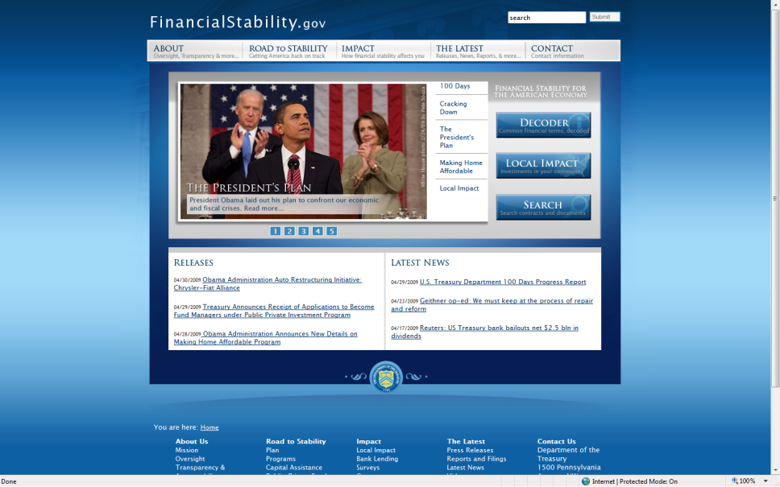
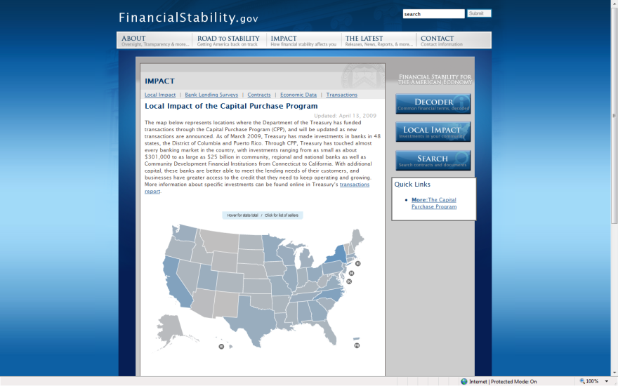
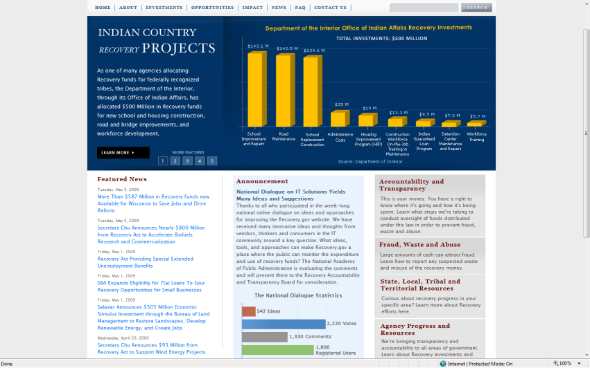
Present Government Efforts Static
Information technology for regulatory agencies has been designed around their stated regulatory responsibilities. Generally, each regulatory organization collects its own data and maintains its own technology platforms necessary to perform their regulatory function. Effective information sharing would provide the transparency and analysis necessary to effectively monitor the systemic risk in the financial system.
These disparate IT systems have created obstacles as financial services have evolved:
Disparate and proprietary systems cannot be formed into a enterprise architecture to support a global, holistic regulatory framework
Lack of standards for information management prevent agencies from effectively exchanging and utilizing other agencies’ regulatory information
Common tools and applications for processing and managing information across agencies are not available or effectively utilized
Lack of security and data protection standards threaten the exchange and utilization of information across agencies
Lack of flexible and open platforms slows innovation and broadening of knowledge, based on many years of regulatory reform and experience

Slide 25
MS SVP for Compliance and Oversight
Document and Records Retention
  Microsoft and its partners can help align IT and business to embed DMRR best practices into day-to-day processes and workflows.
Transparency, Governance, Risk Management and Compliance
  Ensure agencies and stakeholders comply with requirements while maximizing, extending and embedding Risk Analytics & Reporting best practices into everyday activities.
Payments
  Solutions from Microsoft's partner ecosystem span every aspect of the payments business, including treasury cash management, payments delivery channels, and clearing and settlement.

Slide 26

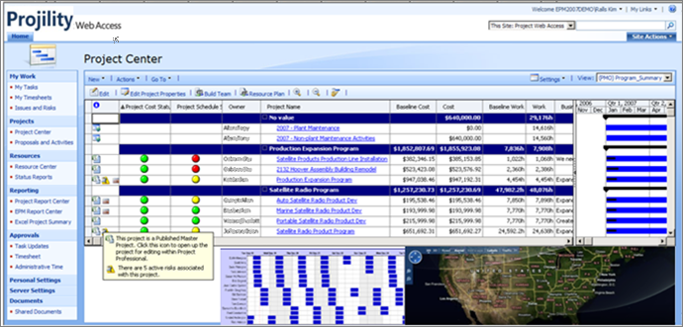
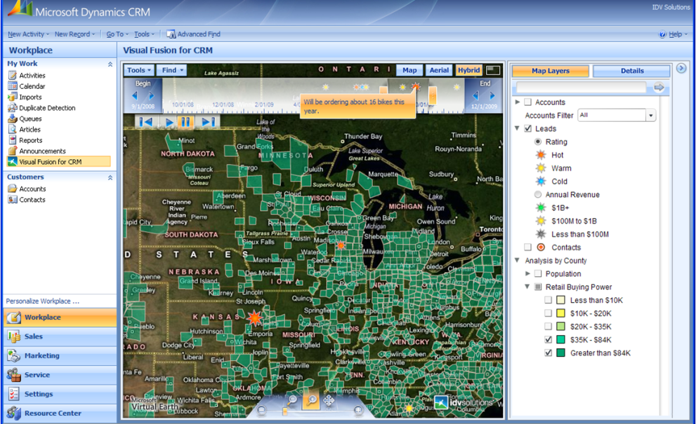
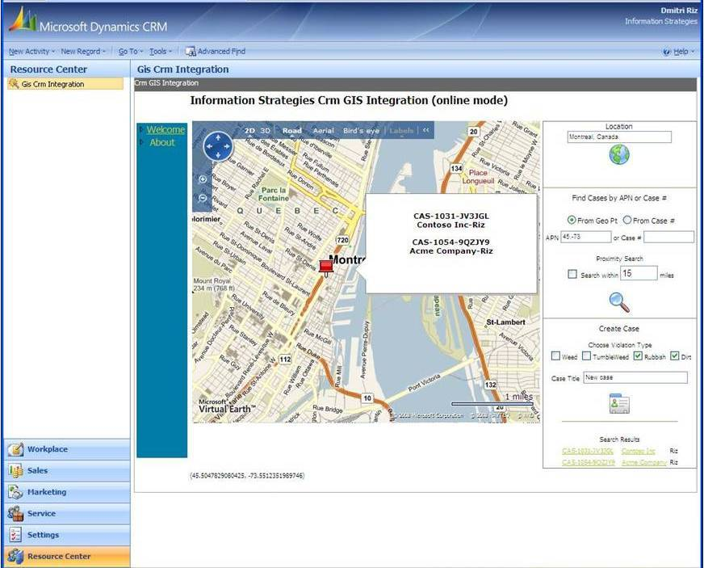
Goal: Real Time Transparency
Dynamic Use of Inter-Agency Data through Microsoft Single View Platform

Slide 27
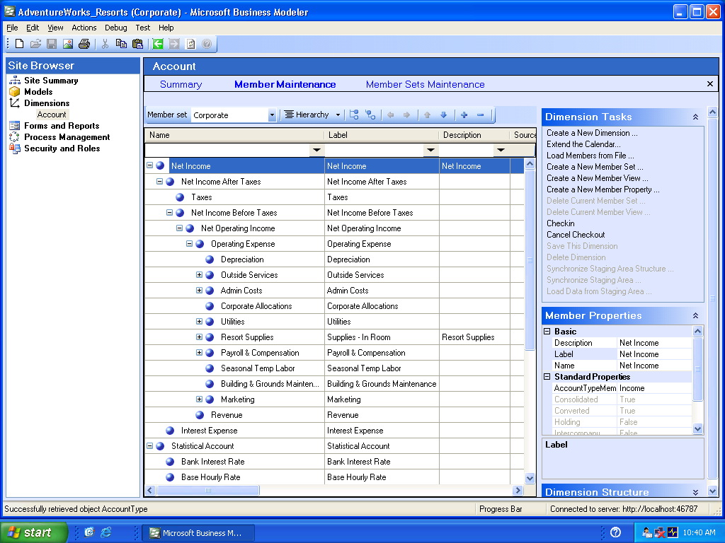
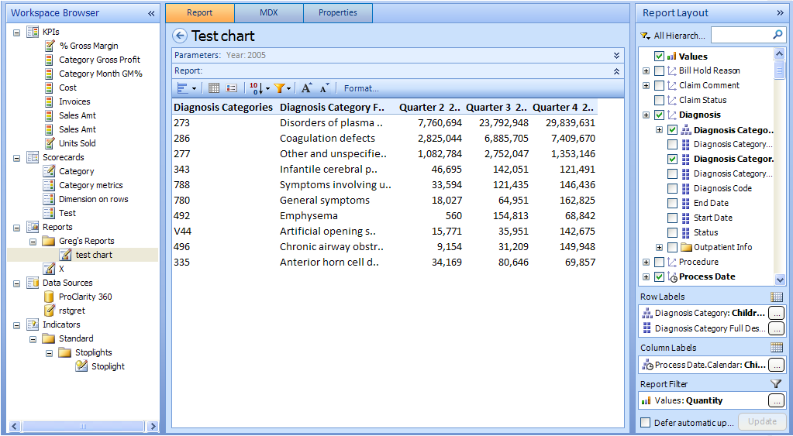
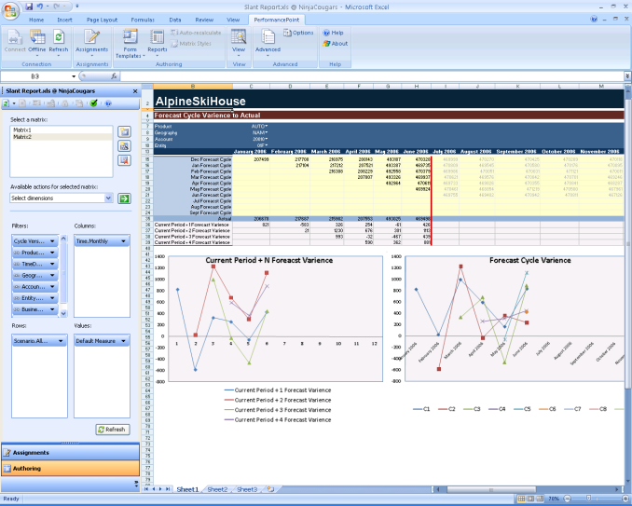
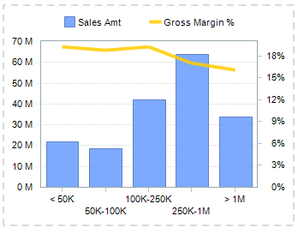
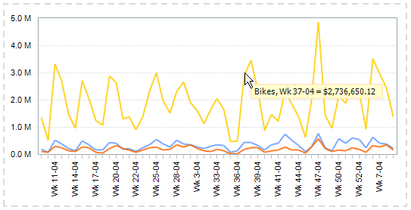
Reporting & Dashboarding
Build, customize and share production quality reports from Excel while being connected to a secure and centrally managed server
Notes:
Key Message: Risk Mgmt needs scorecards, dashboards, for real time risk reporting, and visualization with simple user friendly integrated suite.
Microsoft has introduced its BI stack (PerformancePoint Server) that integrates the earlier Business scorecard Manager, ProClarity analaytics acqusition and SQL SRS.
PerformancePoint is a great tool for overall performance management as Risk and Corp Perf Mgmt converge.

Slide 28
Microsoft® Single View Platform (SVP)
Gina Marie Hatheway
Microsoft Government Programs Manager

Slide 29
Microsoft Single View Platform
Microsoft Single View Platform - Provides users a ‘single view’ of operational information and data, enabling users to turn shared situational awareness into action.
Scenarios Include:
  Emergency response & event management
  Information sharing with coalition partners and nations
  Routine operations for port management & for law enforcement entities
  Executive & Program Management Dashboard for tracking/monitoring financial stability, oversight and transparency compliance requirements.
  Government communications to citizens on tax assessment and reporting; legal management and food safety
  Command, Operations and IT Data Centers
Provides capability to have actionable information and intelligence to meet mission requirements.

Slide 30
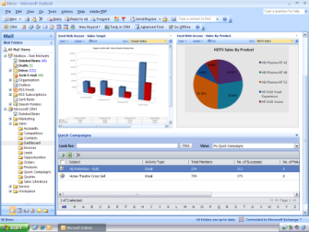




Microsoft Single View Platform
Microsoft “Data Visualization” Concept and Architecture
Government Solutions
Business Intelligence &
Analysis
Work Flow & Business Process
Systems Management &
Virtualization
Enterprise Project Management
Data Visualization “Microsoft Single View Platform”
Government Enterprise Data
Vertical scenarios can plug seamlessly into the
Microsoft SVP basic architecture.

Slide 31
Microsoft Single View Platform
Open architecture based on industry standards
  Integrates seamlessly into existing desktop and server infrastructure
User-friendly interface
Can be configured to meet government requirements for security and continuity of operations
Operates in limited bandwidth environments
Interoperable
  Integrates multiple GIS data sources, legacy systems, and current government capabilities
Based on commercial off-the-shelf technology
Quick turnaround time to build and deploy

Slide 32

Solutions for Transparency
Josh Rice
Microsoft US Public Sector
Director of Incubation Sales

Slide 33



Stimulus 360 Overview
The Microsoft Stimulus360 solution will enable government organizations to quickly mobilize and manage, track and report information on economic stimulus programs
  Funds Management
  Transparency & Accountability
  Job Creation & Sustainability

Slide 34
Stimulus360 Overview – continued
Stimulus360 is a set of prebuilt templates and code designed to help recipients of economic stimulus funds track and manage those resources
Stimulu360 was built upon SVP platform as a specific Microsoft Solution aimed at helping government customers with the demands created by the ARRA process.
Stimulus360 will be provided to customers and partners at no cost
Stimulus360 can be customized to meet each customer’s individual needs
Stimulus360 was built as a solution

Slide 35






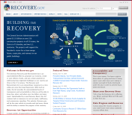














Solution Components - What is it built on?
Recovery.gov
www. Citizen
Facing Site
Collaboration
Planning
Citizen
Govt. Employees
Dept. Heads
Data Storage / Reporting
Program/Project
Management
Dept./Agency Employee

Slide 36
What does Stimulus360 look like?
If it’s vital to you, it’s mission critical to us.

Slide 37
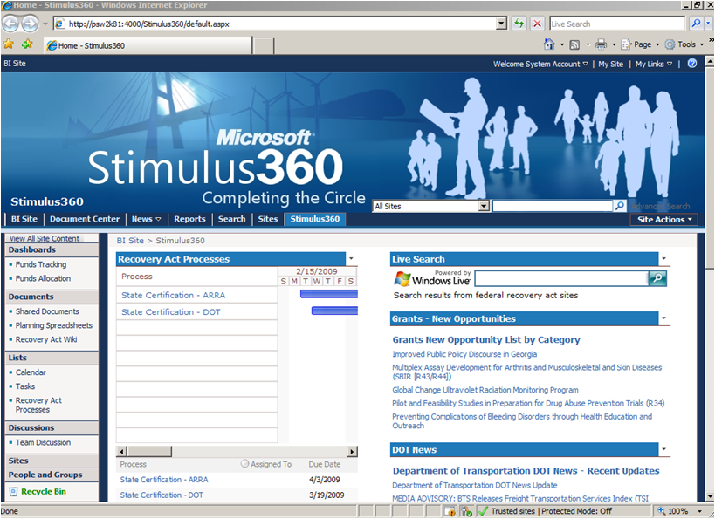
Stimulus360 Home Page
Notes:
Here we see a sample of the home portal for all employees responsible for the economic stimulus package. The portal contains many of the resource and background links needed for an information worker in an SLG entity to: obtain information about the stimulus programs; a shared repository for “a single version of the truth” documents so all staff are working on the same information; a task area for updates; internal wiki and shared information sites; and any other details that your government organization would like to customize. As a common home portal, you can change any of the details reported here as your standard template, and then any of your employees can also customize it to match their exact needs – while still maintaining one common version of the truth.
The home page is a centralized location that is the pulse of the stimulus activities as it relates to a particular state. At a glance you can see performance indicators showing the statuses of incoming and outgoing funds, links to relevant stimulus sites and information, RSS feeds, centralized document store …etc. From this page you can drill down to relevant details of items of interest.
On the next couple of slides I’ll show the rest of this home page.

Slide 38
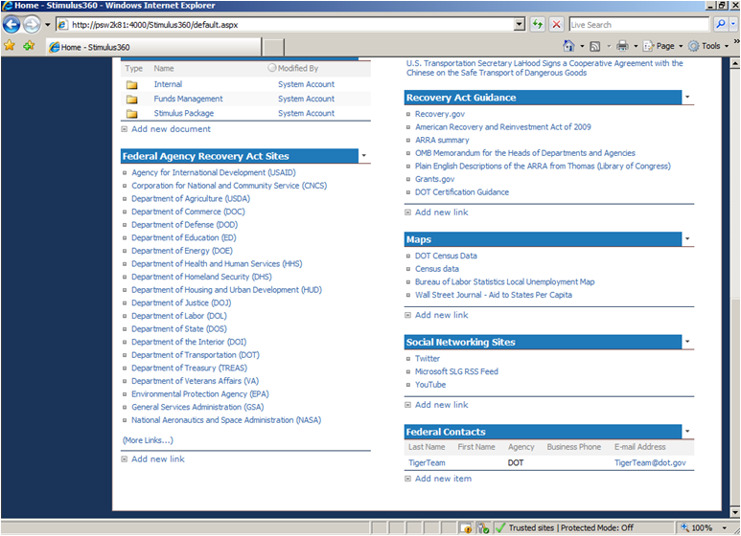
Stimulus360 Home Page (bottom)
Notes:
Here I have scrolled to the bottom of the home page and find many additional sources of information and contacts. On the left hand side I find an up to date listing of all of the federal agency sites dedicated to the Economic Stimulus program. Instead of having to search for them on multiple pages on the federal recovery site, you are able to find all of the links you need right here on the home page.
As a common repository for all recovery act guidance, we have a library established on the right side of the portal. As new requirements are issued they can be added to this library so every employee has one common place to find the latest updates.
Below that section we have included links to critical maps and graphical content related to the stimulus package – since we know that a picture is worth 1,000 words. I’m show you our mapping integration a little later in the demonstration.
Next are links to the main social networking sites. These have become a popular way for many of your citizens to keep up to date on their government operations so we have put place holders here for you.
And finally on the bottom right corner we have started to build a list of key contacts as they are identified throughout the economic stimulus package. You can continue to add to our links and even put your own internal contacts in this list so they are all easy to find.

Slide 39
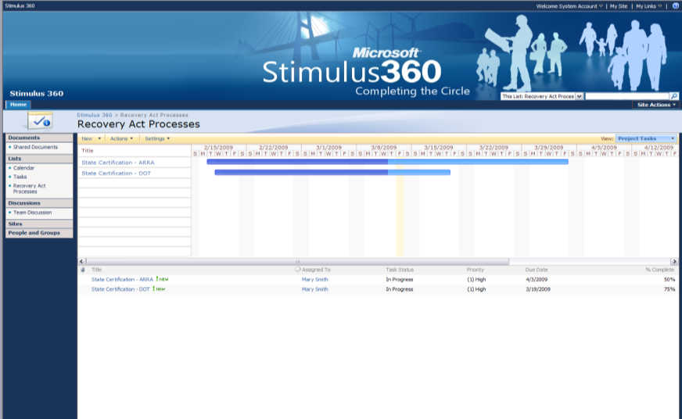
Stimulus360 Process Management
Notes:
Back in the center of the home page I had an area called Recovery Act Processes, which is where we can highlight key time frames and deadlines in an easy to follow format. I’ve expanded that section here for you to more easily see the content, and what you see is we are initially tracking our ARRA certification processes – both at the state and the DOT levels.
Stimulus360 allows you to easily add additional key dates and timeframes by simply filling out an easy to use web form.

Slide 40
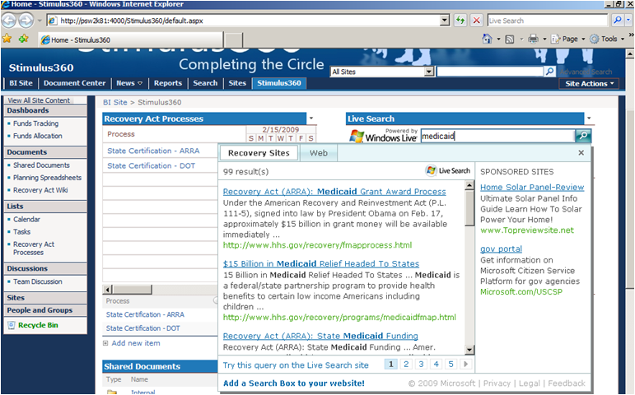
Stimulus360 Live Search
Notes:
With so much of the Stimulus data scattered across many different government web sites, we knew that many internet searches for information would need to be a core function of working with the stimulus program. We have implemented a targeted Live Search which allows you to find exactly what you need without retrieving every possible non-government site that uses the stimulus terms. If you want to do a broad internet search you still can, but we found this targeted search to be much more beneficial to the Economic Stimulus staff.
In this example, I entered the word “medicaid” and immediately received a summary list of links that address Medicaid from the federal agencies managing the stimulus funds. Just having this tool allowed me to eliminate going to the HHS main web site, then finding the stimulus page, and then searching for medicaid. I was able to do it all right from the Stimulus360 home page!

Slide 41
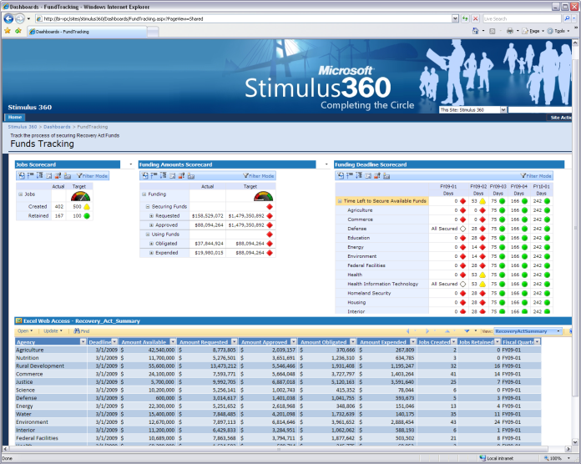
Stimulus360 Funds Management
Notes:
This page shows a sample of how a state could track their Economic Stimulus funds in the initials phases. On the left hand side we see a “jobs created” performance measure to keep track of the jobs as they are reported. In the center and right side we track the state level funds requested vs. the maximum available – making sure that your state receives all of the funds available and meets the mandatory deadlines.
To keep this solution simple and flexible to use, at the bottom we are showing the Stimulus funds displayed in an Excel web access window. By using Excel as a web or “cloud based access” point this prevents multiple different versions of the data being created and then quickly falling out of sync with each other. By pulling the latest common data whenever this screen is opened in a web browser, you insure that everyone is working from the same data.
This solution is also designed to allow you to pull your data from any financial system to integrate into this platform.

Slide 42
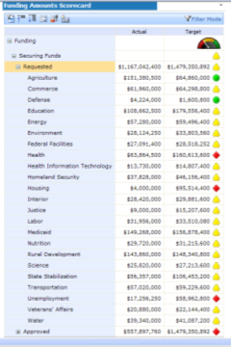
Stimulus360 Funds Management
Notes:
In this screen I’ve simply expanded the center section of the funding scorecard to allow me to see all of the sources.
Everything that I do in this portal is from a simple web page interface so there is no steep learning curve for your users to get this quickly up and running.

Slide 43
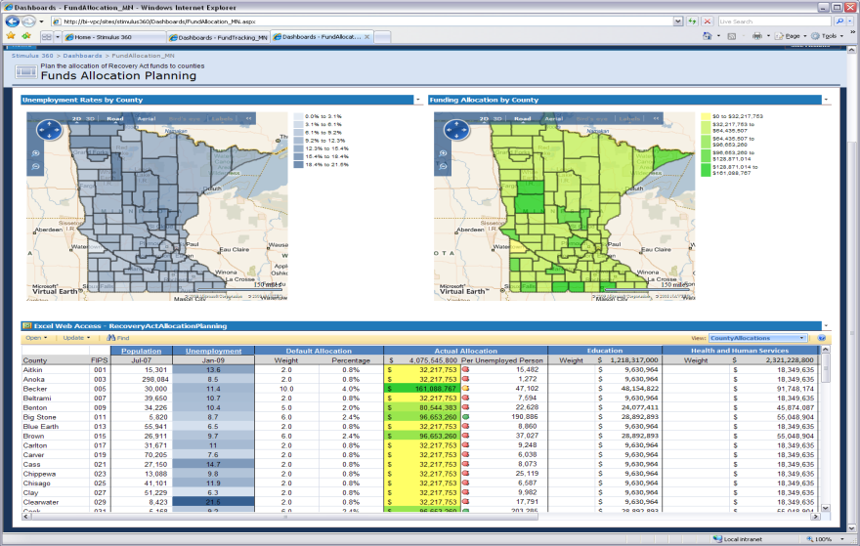
Stimulus360 Funds Allocation
Notes:
In order to help you manage the impact of the Stimulus funds across the state, this example allows for a side by side county comparison of your most recent unemployment data compared to the Stimulus funds distributed by county. This type of comparison could also be made by congressional or legislative districts.
On the left hand side we see the most recent unemployment rate by county in a heat map to easily show the differences in various parts of the state. As in our earlier example, we have made this data source an Excel web access view so your staff can easily update this summary whenever you receive more current data.
On the right hand side we see the distribution of the Stimulus funds in another heat map.
At the bottom of the screen we see the Excel data source driving these maps, and I will show that in more detail on the next slide.
As an enhancement to the mapping component, as you award projects and you maintain address information with each project their details could also be located and displayed on the map – all the way down to a street level view of the project.

Slide 44
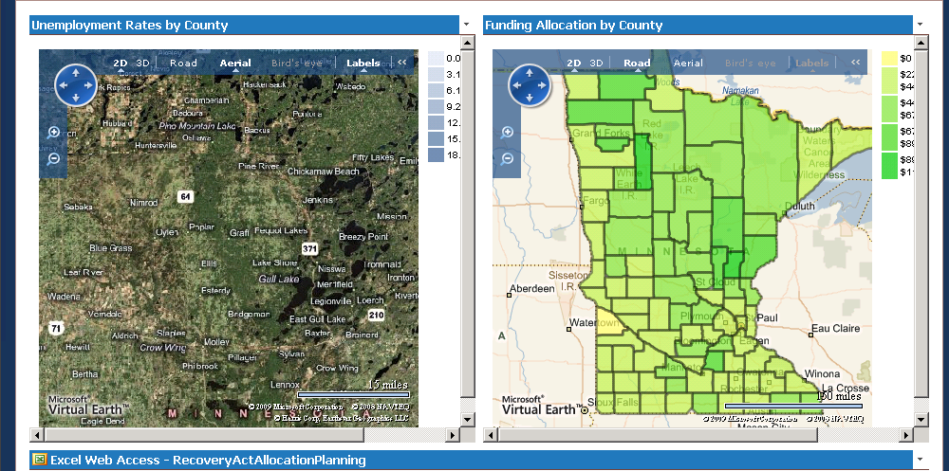
Stimulus360 Geospatial Component
Notes:
Access the full power of Virtual Earth as you manage your Economic Stimulus funds!

Slide 45
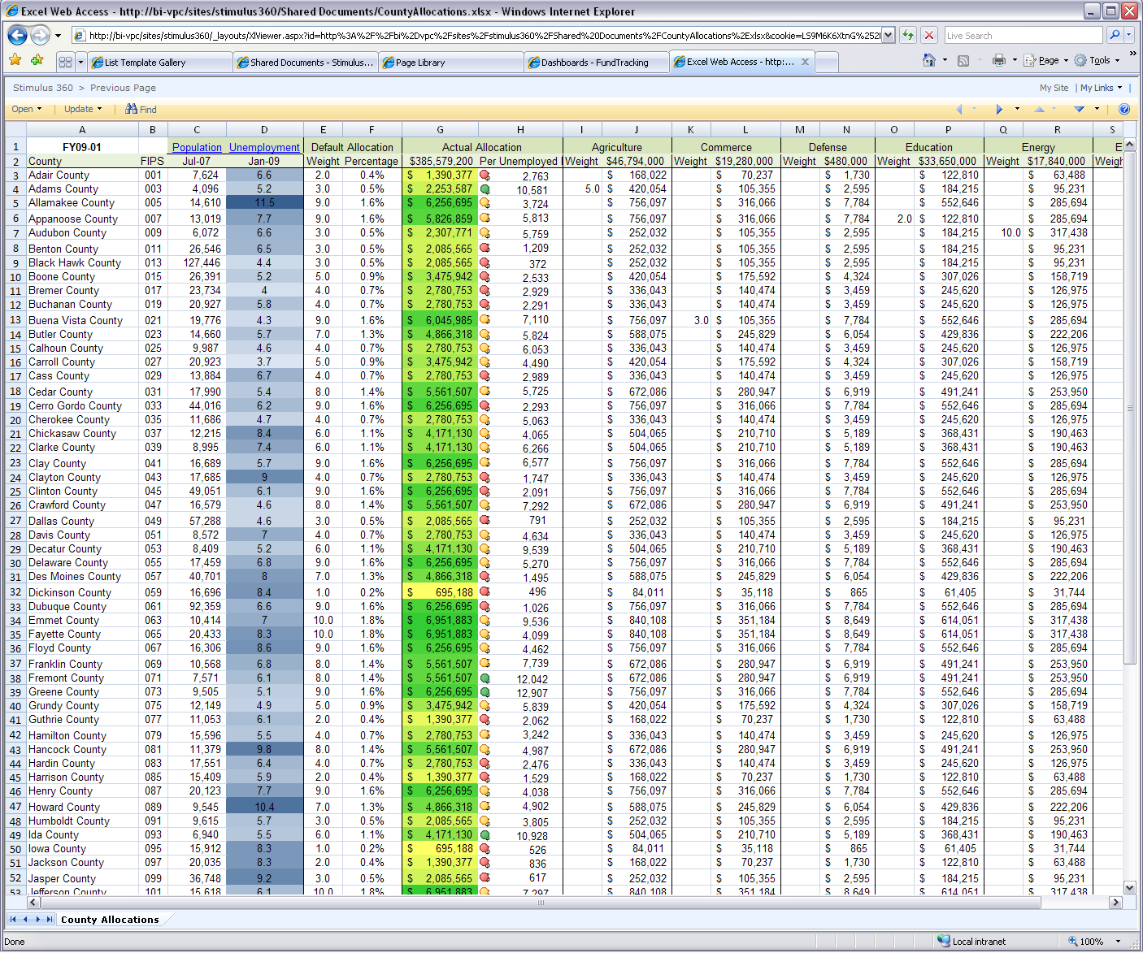
Stimulus360 State Impact
If it’s vital to you, it’s mission critical to us.
Notes:
Here is an enlarged view of the Excel Services web screen. We have given you the ability to distribute the funds by county through a weighted measurement system. For example, if you want to insure that you are prioritizing job related Stimulus funds to your areas of highest unemployment you can use the Excel spreadsheet for projecting a number of “what if” scenarios.
The heat map portion of the columns helps you identify where you are making your maximum efforts.

Slide 46
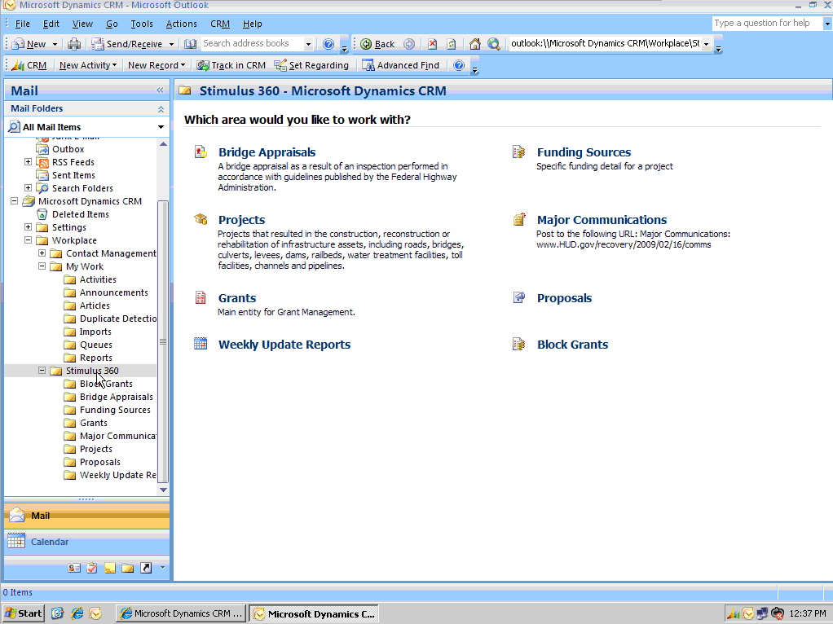
Stimulus360 Project Portal
If it’s vital to you, it’s mission critical to us.
Notes:
Everything I showed so far was the high level view of your stimulus funds. Now we are going to move down into the specific project and fund tracking required by the program. This screen shows how we can use our familiar Microsoft Outlook email client as a front end to the detailed project tracking.
One of the keys to implementing Stimulus360 so quickly is we want your staff to use the tools that they are already trained to use and familiar with.

Slide 47
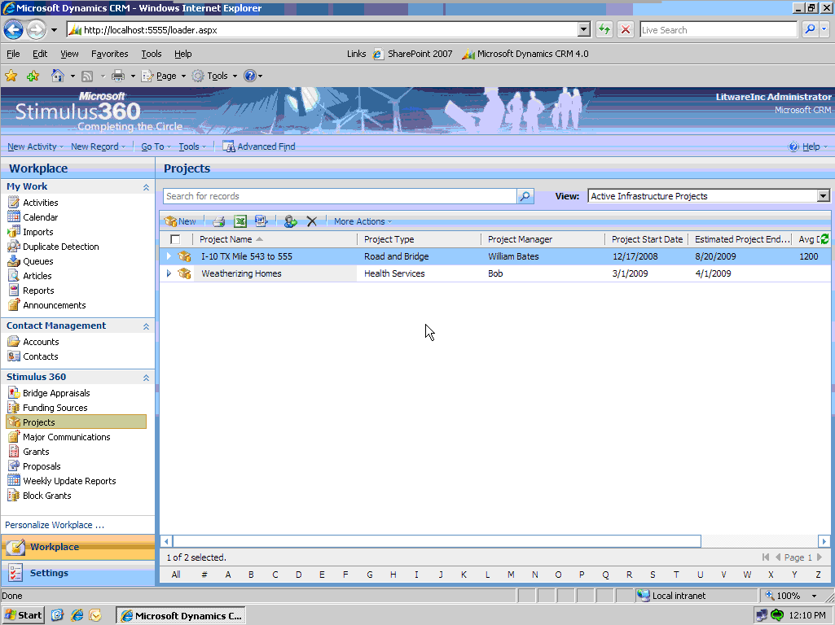
Stimulus360 Project Management
Stimulus360 manages the lifecycle of incoming and outgoing funds including performance & impact management, transparency and reporting
Notes:
After handling the incoming funds, our solution turns to addressing all aspects of outgoing funds. This includes grants, requested projects, awarded projects , reporting requirements, management and tracking. The state will be able to centralize the management of the stimulus funds in one collaborative environment that represents one version of the truth and allows quick response in a dynamically changing environment.

Slide 48
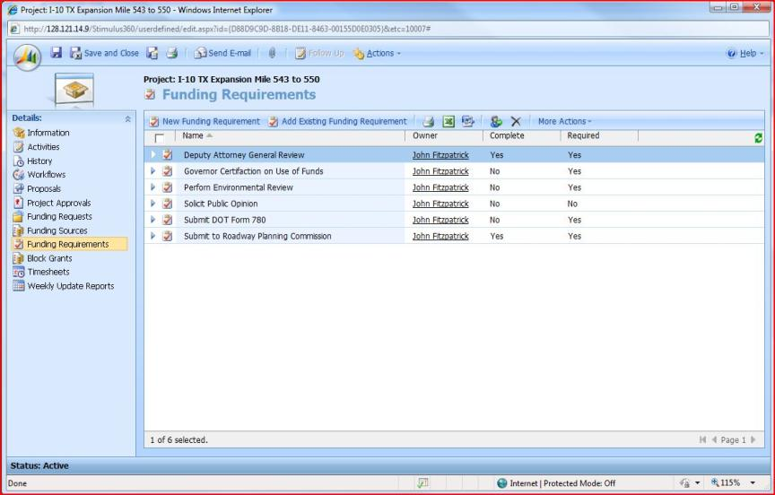
Stimulus360 Funding Requirements
Notes:
Here we are seeing a sample summary screen of the various projects approved for stimulus funding. We want to track and identify each project’s funding source(s) through this process.

Slide 49
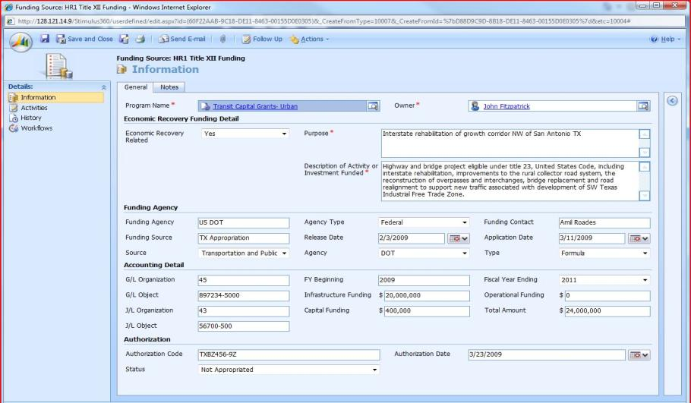
Stimulus360 Project Funds Sources
Notes:
Here I have opened up a project for this detailed project funding source screen I am able to identify the exact source(s) of funds for all stimulus projects, the account and authorization codes, and anything else I need as required data to report on both funds management and job creation and retention. We wanted to make sure that what we provide to you is based upon a flexible design so as additional federal/state requirements are released, the system can be updated without requiring an extensive rebuilding.
We also use drop down choice lists whenever possible so the staff working with the Stimulus funds doesn’t have to look up account and program codes and run the risk of making a typo.

Slide 50
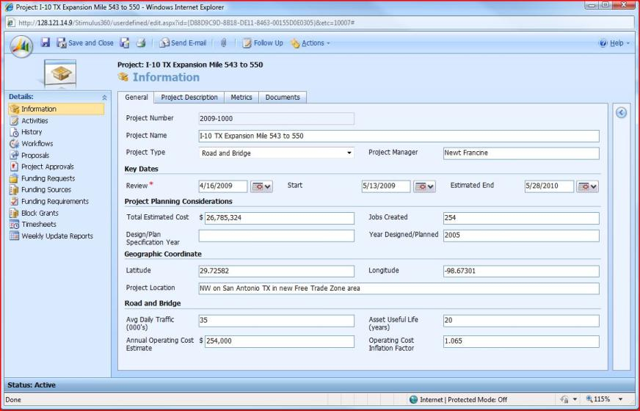
Stimulus360 Project Details
Notes:
Look at the left hand side menu: For every project awarded, complete details are kept including the activities, workflows, history and funding sources. Also, you can filter on the projects by type, date …etc
Every project has certain metrics associated with it and all data is aggregated to the dashboard into a nice visual that shows performance and impact

Slide 51
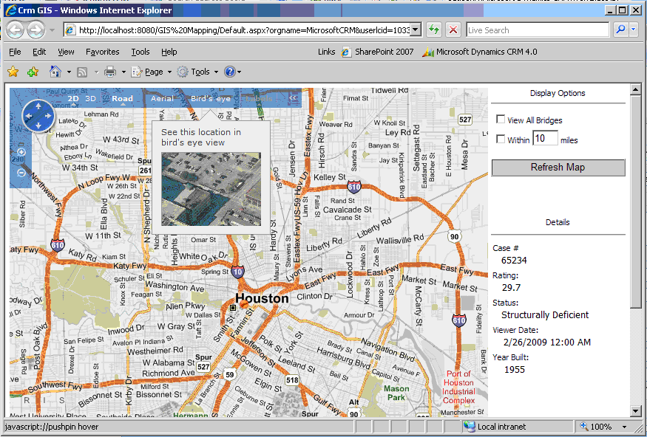
Stimulus360 Project Mapping
Notes:
Stimulus360 has a spatial component to allow for visualizing location-based components. As such, users can use the full power of Virtual Earth to view project locations and details ..etc.

Slide 52
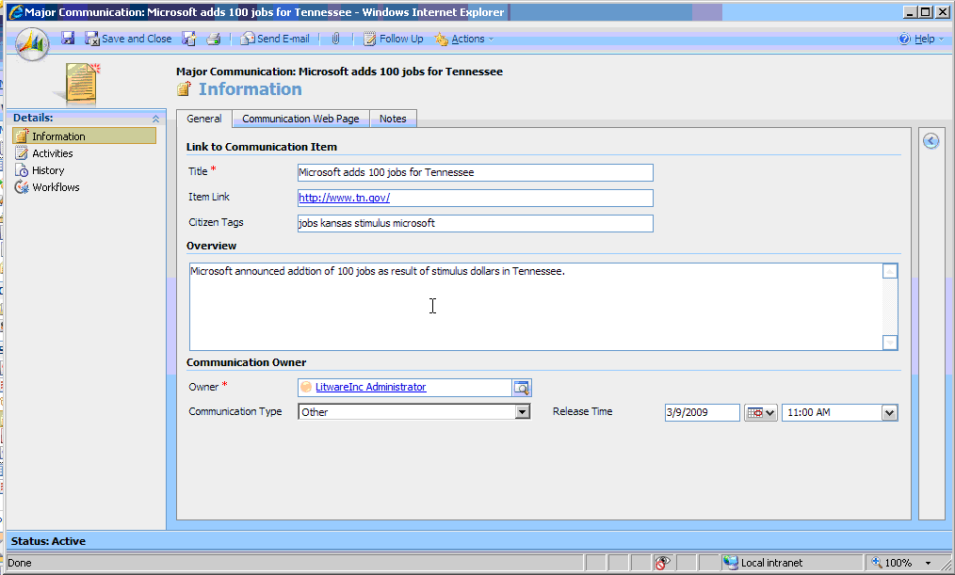
Stimulus360 Major Communications
Notes:
Here is a sample of the reporting aspect of Stimulus360: Major communications. This is a sample screen on generating a press release or announcement. This can be customized to whatever needs you have, and it can be mail merged to a list of press contacts/news sources that you maintain in your tradition distribution methods.

Slide 53
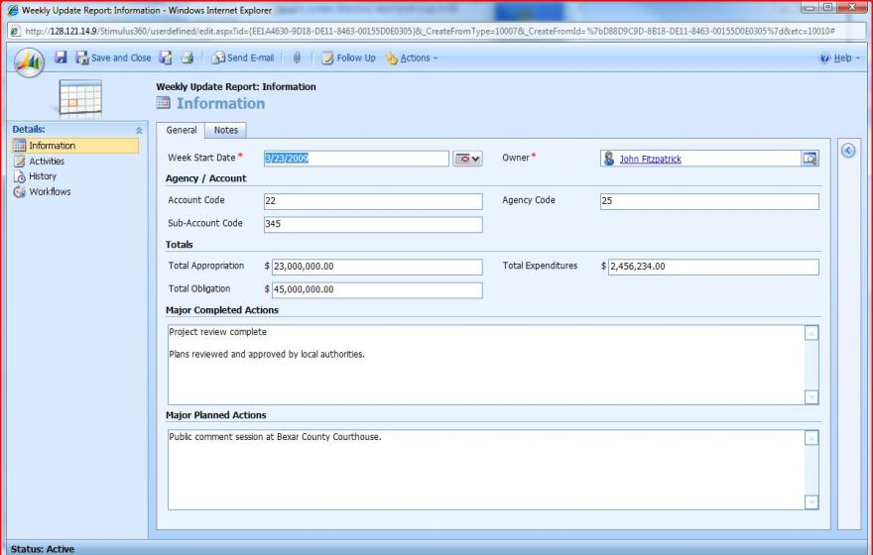
Stimulus360 Weekly Updates Reporting
Notes:
Here is a sample of another reporting aspect of Stimulus360 – the mandatory weekly reports. As with the press releases, you can customize this format to match your exact needs. Everything generated through the system will be tracked in this one central repository, along with the individual projects and funds tracking.

Slide 54
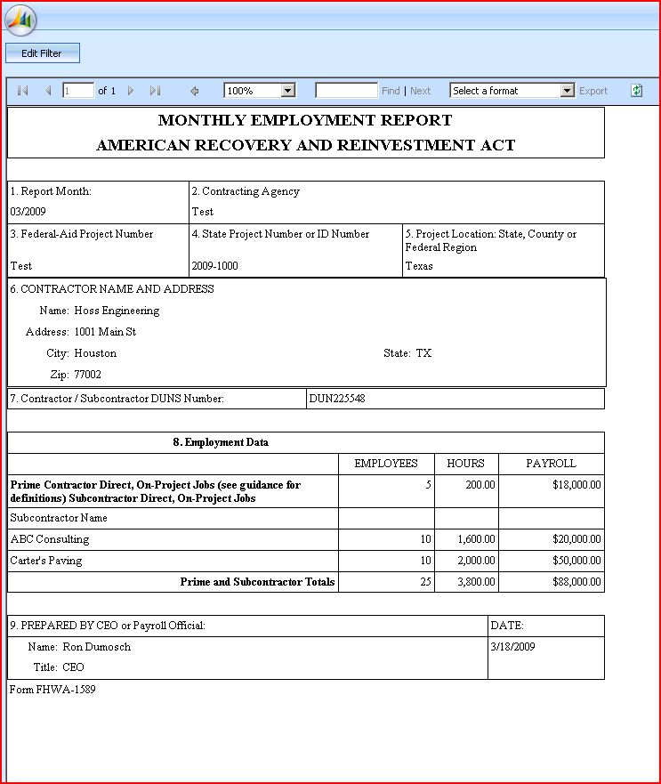
Stimulus360 Mandatory ARRA Report
Notes:
A critical part of the Stimulus program is insuring that you file all of the mandatory reports – weekly, bi-weekly, monthly, quarterly, project based, etc. By having Stimulus360 be your central repository for all project information, you are able to automatically generate such reports without needing to rekey any information.
Here is a sample of a mandatory ARRA monthly report completed through Stimulus360.

Slide 55

Stimulus 360 Summary
End-to-End Funds Management
Fully interactive and easy to use performance dashboards
Track and manage incoming resources and outgoing funds
Full cycle management with drill to details between levels
Accessible and useable by citizens and oversight boards
Transparency & Accountability
Meets requirements for federal, state & local government agencies
Built-in accountability measures
Covers infrastructure and operational purposes funding
Accessibility to each contract awarded or grant issued
Job Creation
Tracks and reports on associated job creation and sustainability
Compares against state-established target metrics
Correlates to state unemployment statistics

Slide 56
Stimulus360 Deployment Scenarios
Stimulus360 will be deployed by the following options:
  Customer site/customer managed
  Customer site/Microsoft host provider managed
  Microsoft hosted provider
Under hosted scenarios customers can receive credit for Microsoft software currently owned
Notes:
We have three types of deployment scenarios for Stimulus360. First we are offering all of the templates/codes available by download to the customer. The customer will take the code and install it in their environment.
The second option is for the customer to have the equipment on their site and have a hosting provider manage it.
The third option is for a totally hosted solution. This option provides Stimulus360 at a per user per month fee. The minimum numbers of users is expected to be 100

Slide 57






Stimulus360
Getting Started
See the Solution in action at: www.microsoftpsdemos.com
Identify software you already have that can help you get started with Stimulus360
      Office 2007
SharePoint ECAL
-SQL Server
PerformancePoint
Dynamics CRM
Contact your Microsoft Representative for more information, including how to get access to the No Cost Stimulus360 Templates
Begin identifying and tracking your ARRA funds and projects within 10 days with our hosted solution!

Slide 58
Thank You
Contacts
  Thom Rubel: 703-485-8408 trubel@government-insights.com
  Gina Marie Hatheway: 703-673-7636, ginamarh@microsoft.com
  Ken Knueven: 703-203-2727, kenk@microsoft.com
  Josh Rice: 425-705-1332, joshuar@microsoft.com
For more information on Microsoft Single View Platform, visit www.microsoft.com/government/svp
For more information on Microsoft Stimulus 360, visit www.microsoft.com/government/stimulus360
Follow us on Twitter: http://www.twitter.com/visualizegov

Slide 59

© 2009 Microsoft Corporation. All rights reserved. Microsoft, Windows, Windows Vista and other product names are or may be registered trademarks and/or trademarks in the U.S. and/or other countries.
The information herein is for informational purposes only and represents the current view of Microsoft Corporation as of the date of this presentation. Because Microsoft must respond to changing market conditions, it should not be interpreted to be a commitment on the part of Microsoft, and Microsoft cannot guarantee the accuracy of any information provided after the date of this presentation.
MICROSOFT MAKES NO WARRANTIES, EXPRESS, IMPLIED OR STATUTORY, AS TO THE INFORMATION IN THIS PRESENTATION.

